Slide 1









User Generated Content Analytics Image Analytics October 23
Dr. Anitesh Barua
David Bruton Jr. Centennial Chair Professor in Business
Distinguished Fellow, INFORMS Information Systems Society
University of Texas Distinguished Teaching Professor
Associate Director, Center for Research in e-Commerce
McCombs School of Business, University of Texas at Austin
Email: aniteshb@gmail.com

Slide 2
Image Analytics: Why Bother
Images (and videos) contribute much more to big data than text (or numbers)
> 3B images posted per day on social media
> 80% have no text attached
Medical images in healthcare
Can provide additional insights

Slide 3

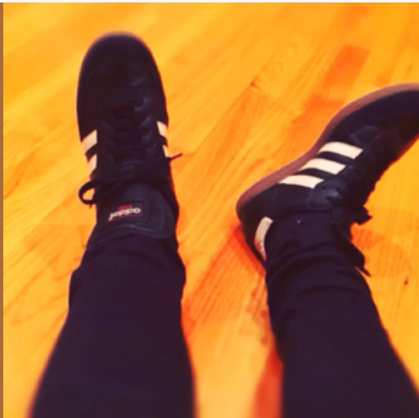

What Does an Image Reveal?
Dubai you will be missed.
Thank you for the inspiration
and the reset. Back to work now. 💙🌺
Post by Skrillex

Slide 4
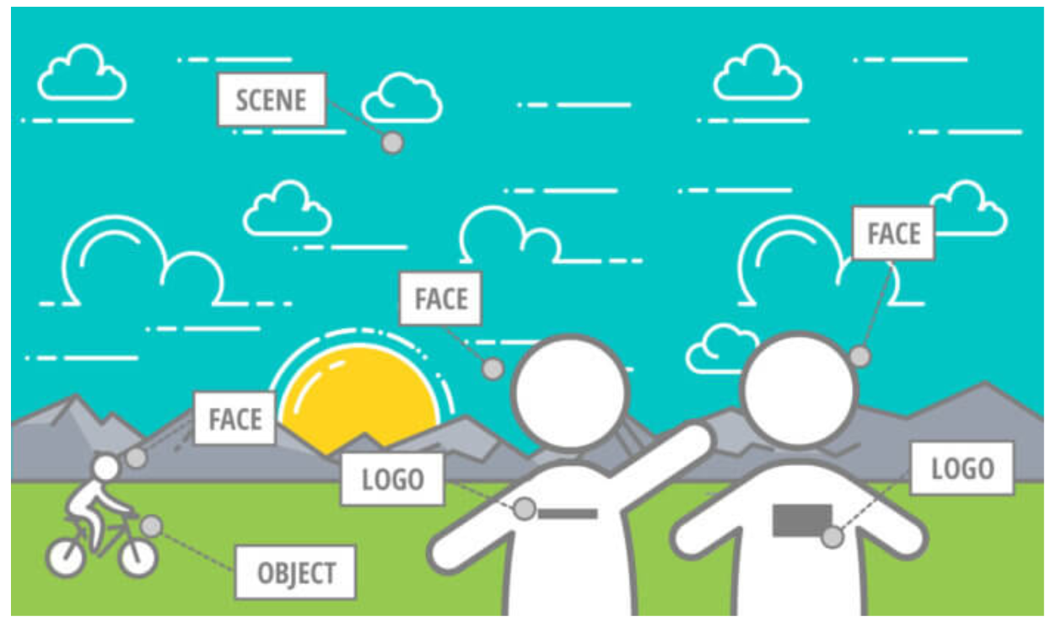
Many Elements

Slide 5
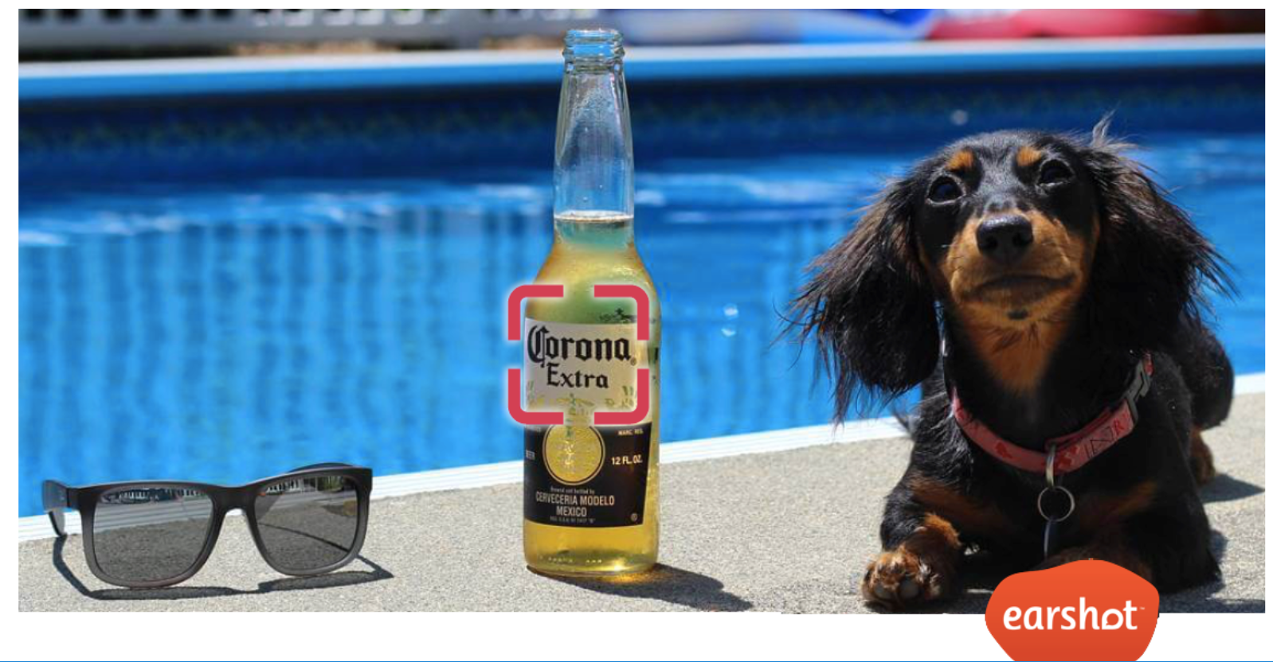
Moments of “Truth”

Slide 6
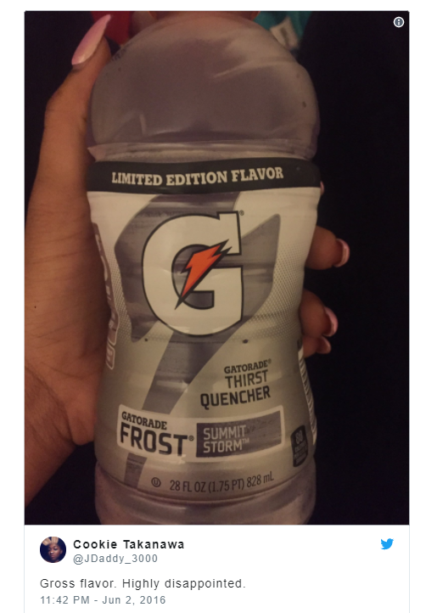

Whole > Sum of Parts?

Slide 7
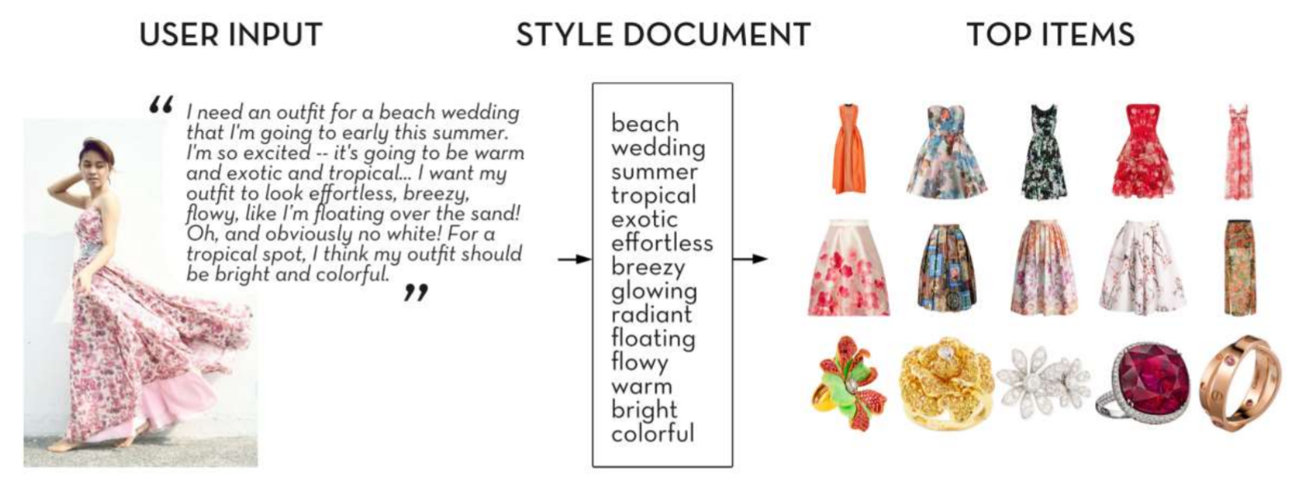
Combining Insights from Text & Images
Source K. Yamaguchi, 2017

Slide 8
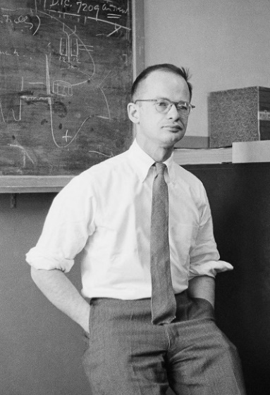
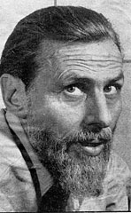

Based on Neural Networks
Warren McCulloch & Walter Pitts:
How neurons work (1943)
https://medium.com/@tifa2up/image-classification-using-deep-neural-networks-a-beginner-friendly-approach-using-tensorflow-94b0a090ccd4

Slide 9
A Simpler Example: A Basic Neural Network with Numeric Data & Classification
Carbs in a cereal | Fiber in a cereal | Acceptance by consumers
.2 | .9 | 1
.7 | .1 | 0
.5 | .3 | 1
.9 | .3 | 0
.6 | .5 | 1
.3 | .1 | 0
.6 | .3 | 1
.8 | .2 | 1
.6 | .3 | 0
Task: Build a model to classify if a new cereal design would be accepted

Slide 10
A Simple Neural Network
Input layer
Hidden layer
Output layer
A constant c₃
 | Initial value
w₁₃ | .05
w₂₃ | .01
c₃ | -.3
w₁₄ | -.01
w₂₄ | .03
c₄ | .2
w₁₅ | .02
w₂₅ | -.01
c₅ | .05
w₃₆ | .01
w₄₆ | .05
w₅₆ | .015
c₆ | -.05
Weight w₁₃
1
*
3
Carbs
Output = .43
.2
w₁₄
c₄
w₃₆
c₆
w₁₅
4
Output = .51
6
w₄₆
w₂₃
Output = .506
*
w₅₆
c₅
For .5 cutoff,
classify as “1”
w₂₄
Output = .51
2
Fiber
5
w₂₅
.9
Initially c₃, w₁₃ and w₂₃ are randomly chosen
Output of 3: First calculate s = c₃ + w₁₃*.2 + w₂₃*.9
= -.3+(.05*.2)+(.01*.9) = -.28
Then a function of s is taken. Popular function is 1/(1 + exp(-s)) = .43

Slide 11
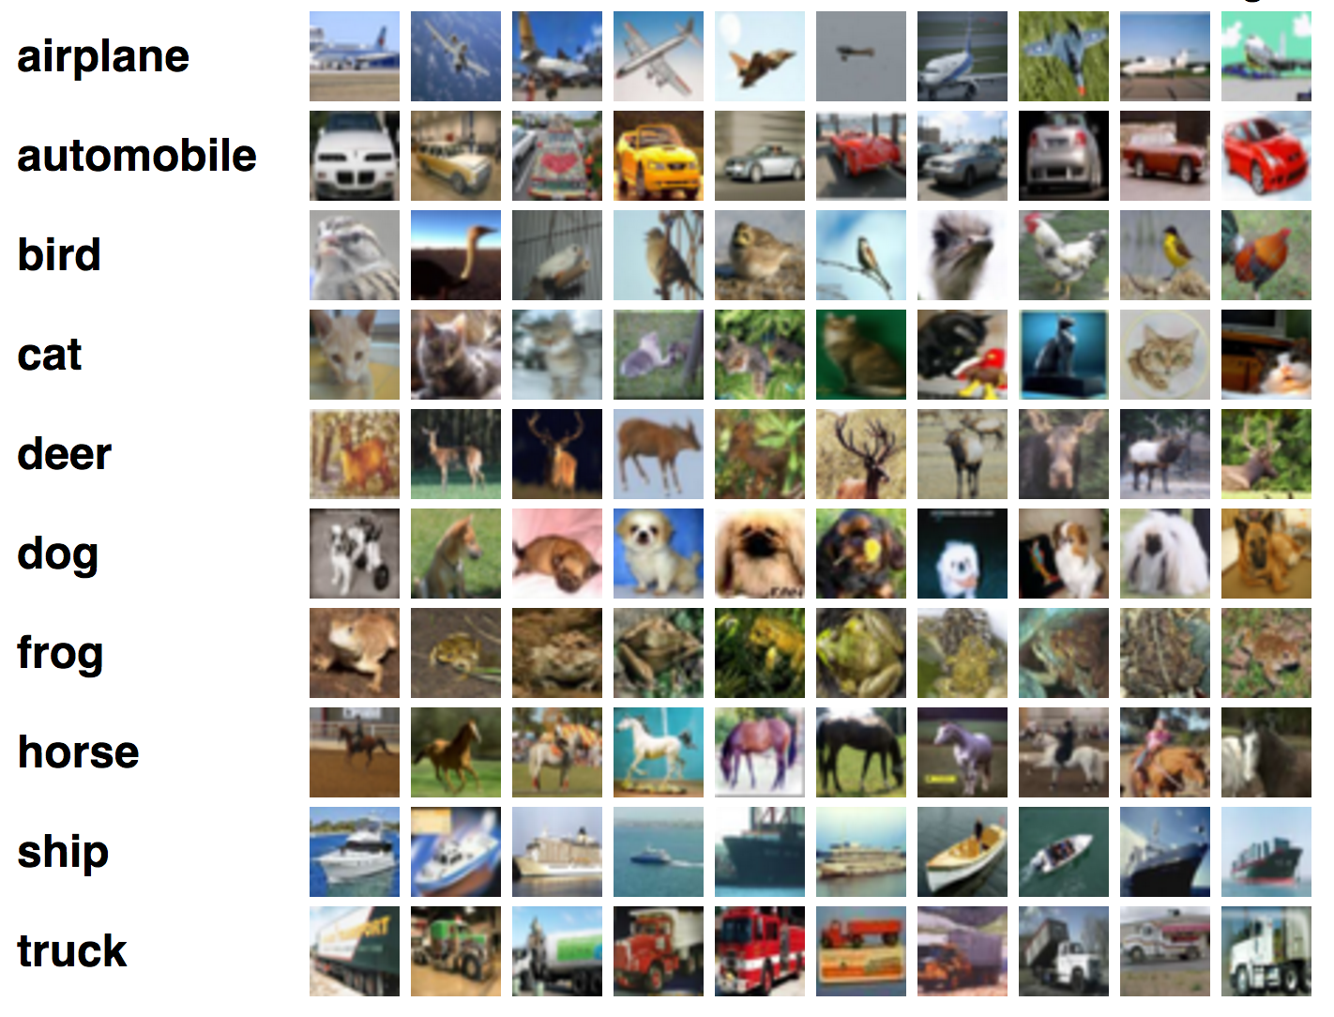
Sample “Training” Images
https://medium.com/@tifa2up/image-classification-using-deep-neural-networks-a-beginner-friendly-approach-using-tensorflow-94b0a090ccd4

Slide 12
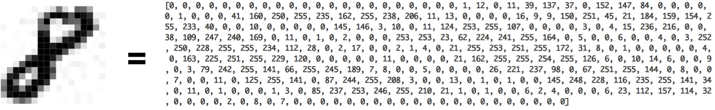
A Simplified View
Convolution layer(s) in a neural network
An image is broken up into a number of “tiles”
The algorithm tries to predict what each tile is
Predict what’s in the picture based on the prediction of all the tiles
https://ujjwalkarn.me/2016/08/11/intuitive-explanation-convnets/
http://scs.ryerson.ca/~aharley/vis/conv/ for visualization

Slide 13
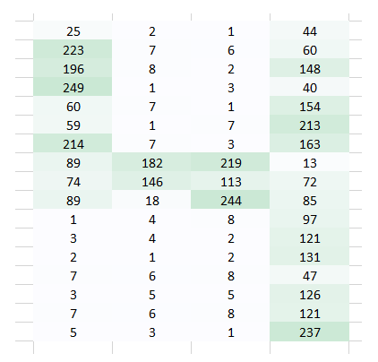
A Computer’s View of an Image
Pixel representation
Single “channel”
“1” for white
“255” for darkest shade of green
Source: D. Gupta, 2017

Slide 14
How Would a Traditional Neural Network Recognize the Number?
“Flatten” the pixel data
Each pixel an input
Problems with this approach?
Source: D. Gupta, 2017

Slide 15
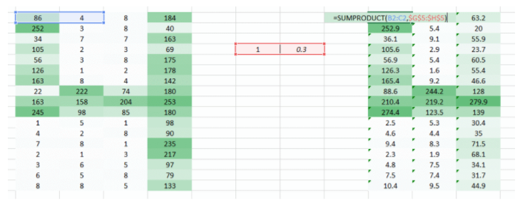
Retaining Spatial Information
Need to send a 2D (or 3D) arrangement of pixel values to a
neural network
Take 2 or more pixel values at a time, and suitable weights
What changes do you see on the right?
Source: D. Gupta, 2017

Slide 16
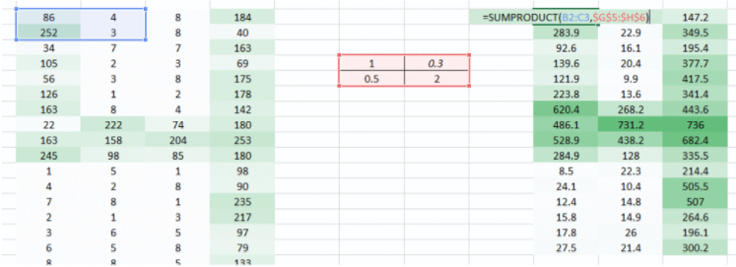
Preserving the Spatial Arrangement of Pixels
Weight matrix, aka “filter”
Source: D. Gupta, 2017

